Slide 1
CSE 170 Technical Teamwork Fall 2024
Making you awesome – so you can be a better teammate.

Slide 2
Opening Prayer

Slide 3


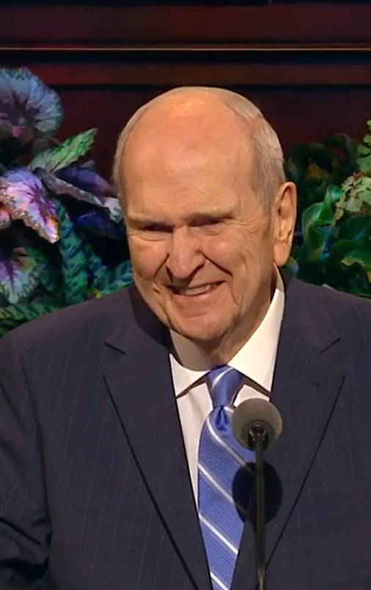

Spiritual Thought - Conflict
Anger never persuades. Hostility builds no one. Contention never leads to inspired solutions. Regrettably, we sometimes see contentious behavior even within our own ranks. We hear of those who belittle their spouses and children, of those who use angry outbursts to control others, and of those who punish family members with the “silent treatment.” We hear of youth and children who bully and of employees who defame their colleagues.
My dear brothers and sisters, this should not be. As disciples of Jesus Christ, we are to be examples of how to interact with others—especially when we have differences of opinion.
Russell M. Nelson - Peacemakers Needed – April 2023

Slide 4
Agenda
Self-Management
Assignments
Review assignments and due dates
Initial the roll
Unit 3 Overview
The Language of Commitment
Time Management – Final Thoughts
Conflict Management Styles & Strategies
Announcements

Slide 5


Slide 6
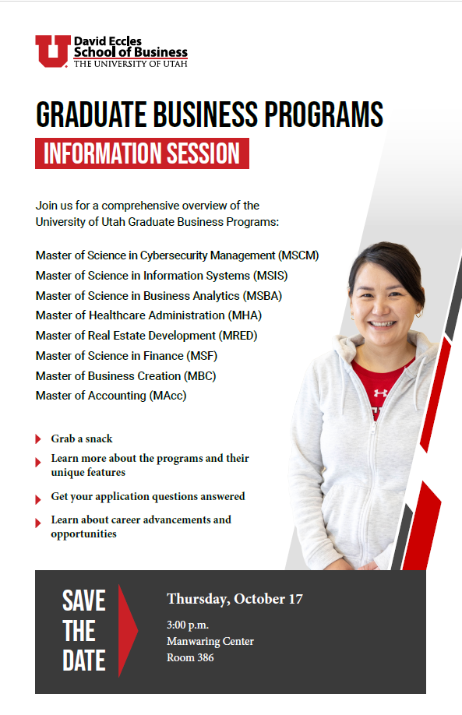

Slide 7


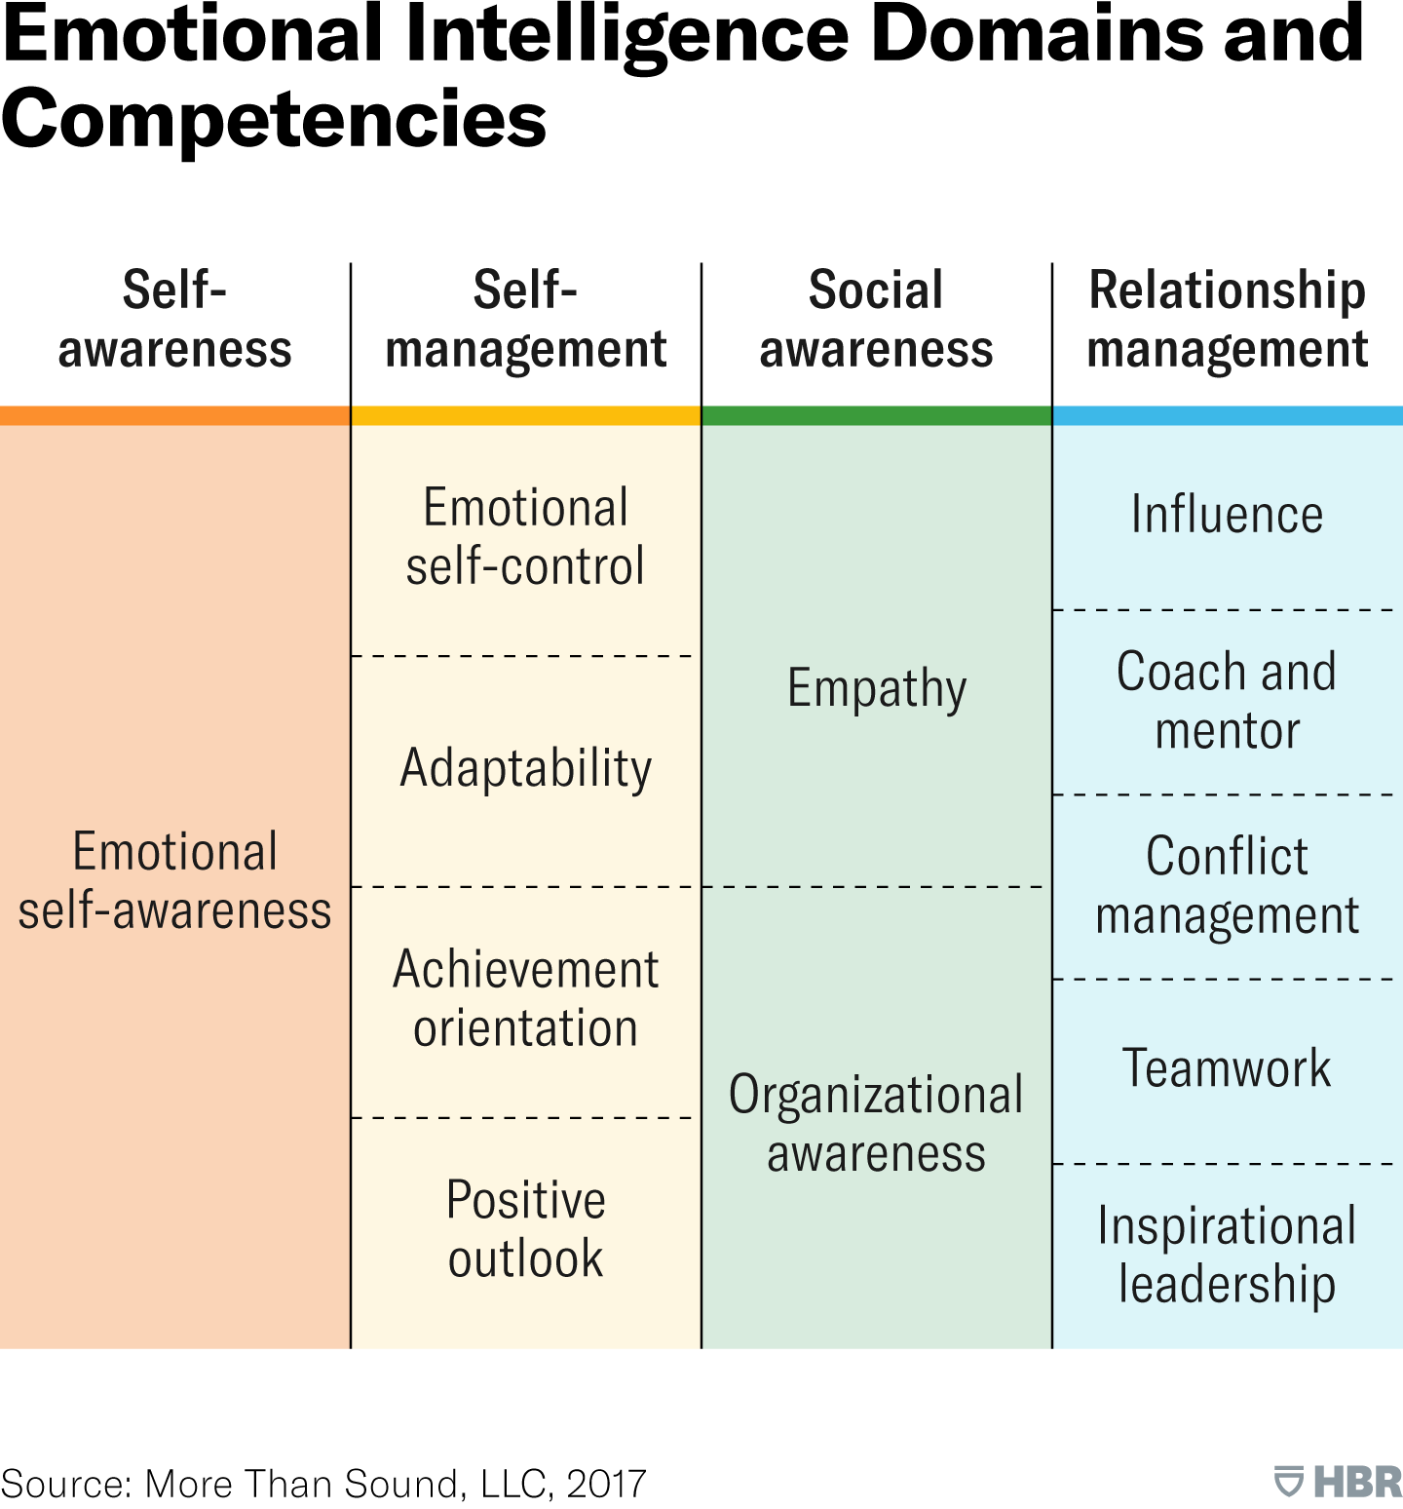

Emotional Intelligence

Slide 8
Time Management – Final Thoughts
Sleep Schedule
The positive benefits of getting the right amount of sleep cannot be overstated.
https://summer.harvard.edu/blog/why-you-should-make-a-good-nights-sleep-a-priority/
Screen Time
Most students identified screen time as their biggest time-waster.
Prioritize relationships and interaction with people.
Let hard limits on how much time you spend scrolling
Check out “Tips for getting more sleep as a student” in this blog post

Slide 9

Unit 3 (Weeks 5-8)
Week 5 – Learn about Conflict and Commitment
Kimberly (TA) will run class on Wednesday
Week 6 – Team Project: Brainstorming Problems
Week 7 – Team Project: Identifying Solutions
Week 8 – Team Project: Proposing a Plan + Group Presentations (6/12)
This Photo by Unknown Author is licensed under CC BY-NC-ND

Slide 10
Assignments – Week 5
U03 Prepare: Articulate Team (Commitment & Conflict)
Describe how the language of commitment can help or hinder situations in a team environment.
Explain how conflict relates to team success or failure.
Due Wednesday night
U03 Teach: Analyze Case Study 2
What do you think Phillip should do in this situation?
Be sure to discuss the specific language Phillip should use in forming his response and why.
Also, discuss the conflicts that are present and possible ways of handling them.
Due Saturday Night

Slide 11
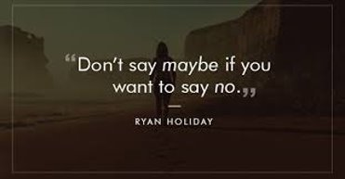
Teamwork - Commitment

Slide 12

Saying “No”
Aren't you supposed to do what your boss says?
No. Not if you are a professional.
Managers and Developers have a job to do
How are they different?
Honest feedback is most valuable when the stakes are high.
Why?
Why is “OK, I’ll try” a bad thing to say?
How can a well-placed “No” lead to a “Yes”?
What are some consequences to saying “Yes” when you should say “No”?

Slide 13

Saying “Yes” With Commitment
How do the following signal lack of commitment?
Need/should: "We need to get this done", "I need to lose weight", "Someone should make that happen".
Hope/wish: "I hope to get this done by tomorrow", "I wish I had time for that".
Let's (not followed by "I..."): "Let's meet sometime", "Let's finish this thing".
What are some barriers to commitment?
I can’t commit because I rely on person X to get this done
I can’t commit because I don't really know if it can be done
I can’t commit because something always comes up

Slide 14
Saying “Yes” With Commitment
What is the language of commitment?
I will... by... (example: I will finish this by Tuesday.)
What is the “professional” way to manage commitment failures?
Own your mistakes and be clear about what went wrong
Suggest an alternate implementation while leaving room for your manager to give guidance.

Slide 15

Commitment at Work – Personal Story
New Canadian Logistics Solution proposed in March 2021
Executives wanted it completed by June
Lots of pressure to make money in Canada.
Everyone on the project knew June was an unrealistic timeframe
We said “we’ll try”
Actual delivery was October
Fallout
Executives lost trust in the development team
They claimed we made a “commitment” to deliver in June.
Development team was frustrated for being blamed.
They claimed no “commitment” was ever made.

Slide 16

Group Discussion
Share a story about a time when you said, “I’ll try” when you should have said “No.”

Slide 17
Conflict Management

Slide 18
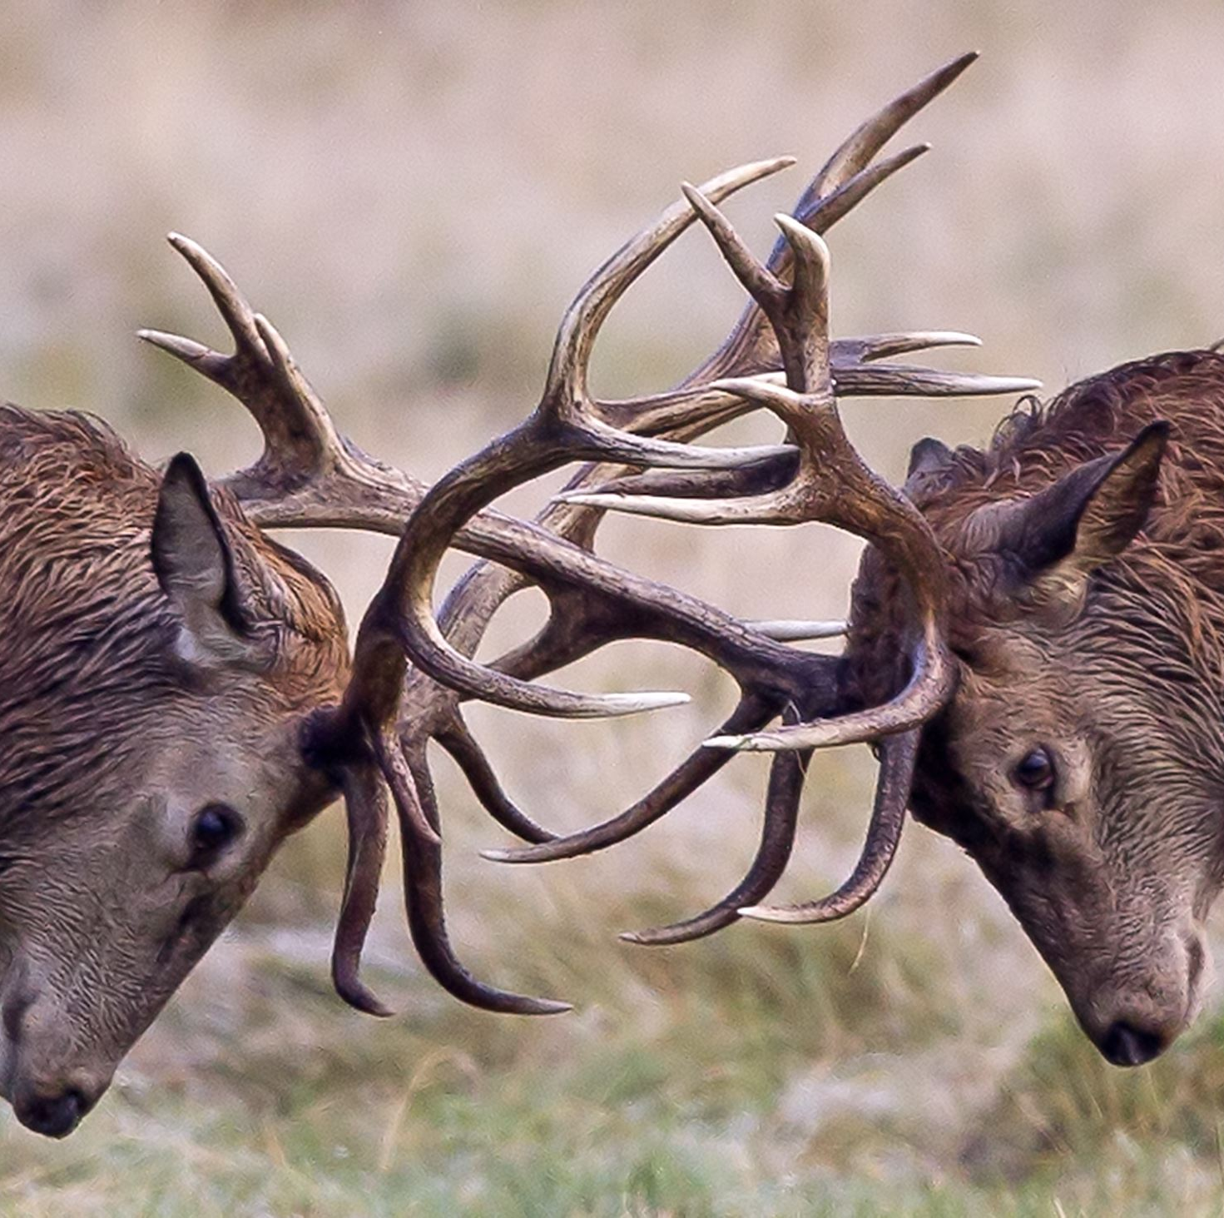
What is Conflict?
What are some causes of conflict?
What is the difference between conflict at work and conflict at home?
How does conflict make you feel?

Slide 19
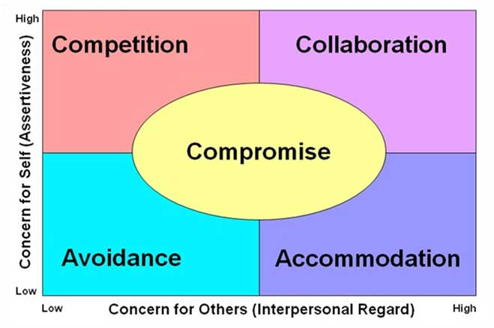
Conflict Resolution Styles
Source: https://sunstone.org/passive-aggression-among-the-latter-day-saints/

Slide 20


Conflict Resolution Styles
Collaborating
Attempt to work with others to identify a solution that fully satisfies everyone’s concerns.
Competing
Assertive and uncooperative and willing to pursue one’s own concerns at another person’s expense.
Avoiding
Unassertive and uncooperative while diplomatically sidestepping an issue or simply withdrawing from a threatening situation.
Accommodating
An element of self-sacrifice when accommodating to satisfy the other person.
Compromising
Find an expedient, mutually acceptable solution that partially satisfies both parties in the conflict while keeping some assertiveness and cooperativeness.

Slide 21
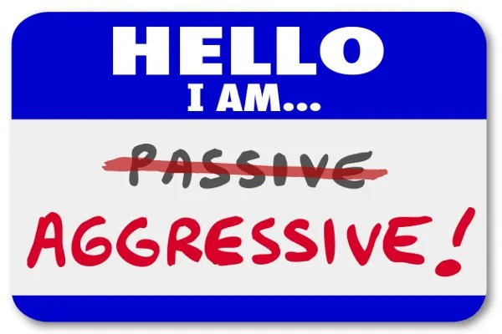
Passive Aggression and Avoidance
A study published in 2013 showed that among many Latter-Day Saints in the western United States, conflict avoidance is a preferred strategy.
This leads to an increased prevalence of passive-aggressive behaviors among the population.
What is passive-aggressive behavior? Examples?
Why does conflict avoidance lead to passive aggressive behaviors?
This Photo by Unknown Author is licensed under CC BY-NC-ND

Slide 22
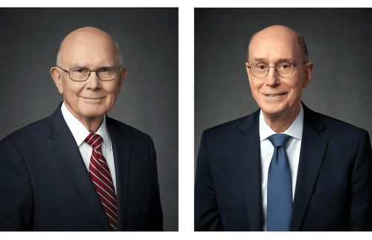
Managing Conflict – The Right Way
Differences of opinion are part of life. I work every day with dedicated servants of the Lord who do not always see an issue the same way. They know I want to hear their ideas and honest feelings about everything we discuss—especially sensitive issues.
My two noble counselors, President Dallin H. Oaks and President Henry B. Eyring, are exemplary in the way they express their feelings—especially when they may differ. They do so with pure love for each other. Neither suggests that he knows best and therefore must rigorously defend his position. Neither evidences the need to compete with the other. Because each is filled with charity, “the pure love of Christ,” our deliberations can be guided by the Spirit of the Lord. How I love and honor these two great men!
Russel M. Nelson – Peacemakers Needed – Apr. 2023

Slide 23

Psychological Safety
A perception that a person has that they can express themselves without fear of negative consequences, such as embarrassment, punishment, or retaliation.
It's the feeling that one's voice and opinions are valued and respected whether it’s in a workplace, team, or any social setting.
Learning to create an environment of psychological safety is critical to loving where you work and retaining your best employees and co-workers.

Slide 24

6 Skills for Managing Conflict
1. Soften Startup
Count to 4 like we talked about
Proverbs 15:1 (NIV) – “A gentle answer turns away wrath, but a harsh word stirs up anger.”
2. Complain but don’t blame.
Describe the behavior, not the person.
3. Make Effective Repairs During Conflict
Make statements that start with “I” instead of “You.”
Focus on how you are feeling

Slide 25
6 Skills for Managing Conflict
4. De-escalate
Describe what is happening, but don’t evaluate or judge.
Look for ways to “turn down the heat” on the situation
5. Psychological Soothing of Self and Partner
Be polite and appreciative.
Don’t use veiled jabs or defensiveness
6. Compromise
This is key to a healthy relationship.
Find the solution that works for both of you.

Slide 26
Group Discussion
Soften Startup
Complain without Blame
Use “I” instead of “You”
Turn Down the Heat
Be Polite and Kind
Compromise

Slide 27

Next Time
Estimation Activity
Phillip Walker Case Study

